Slide 1
Introduction to radio frequency and wireless communications
San

Slide 2
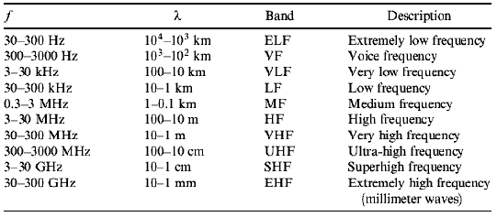
International Telecommunication Union (ITU)

Slide 3
Spectrum for wireless communication products
Product | Spectrum
Digital Audio Broadcasting | 88MHz ~ 108MHz | DAB | Data transmission
Digital Video Broadcasting | 48MHz ~ 863MHz | DVB | Data transmission
Global Positioning System | L1 - 1575.42 Mhz L2 - 1227.60 MHz | GPS | Data transmission
Mobile Phones | Next page | 5th generation mobile networks | Data transmission
Bluetooth | 2.4GHz ~ 2.485 GHz |  | Data transmission
ZigBee | 868MHz ~ 915MHz |  | Data transmission
Wi-Fi | 2.4GHz, 5GHz |  | Data transmission
Collision avoidance system (Radar) | 24GHz 77GHz |  | sensor
Wireless Locating System | 2.4GHz 5GHZ 77GHz | WLS | sensor

Slide 4
The most popular wireless technology
Wireless communication transceivers are widely studied all over the world, especially for data transmission and sensor application.
In recent years, 5th generation mobile network is the most popular research field.
Huawei‘s 5G solution does not include the microwave band.

Slide 5
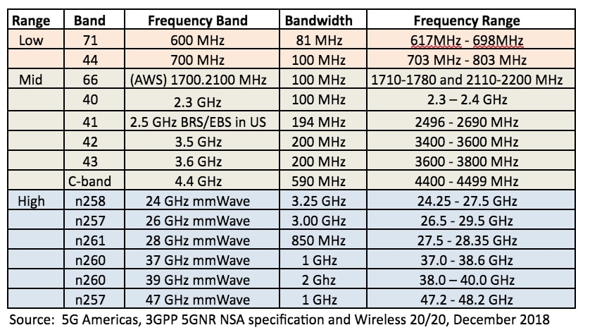
Spectrum strategies for 5G: 2019 update

Slide 6
Wireless communication systems
Wireless communication technology is a type of data communication technology that is performed and delivered wirelessly.
The main components of wireless transmission system are the antenna, transmitter and receiver. (RF circuit only)

Slide 7
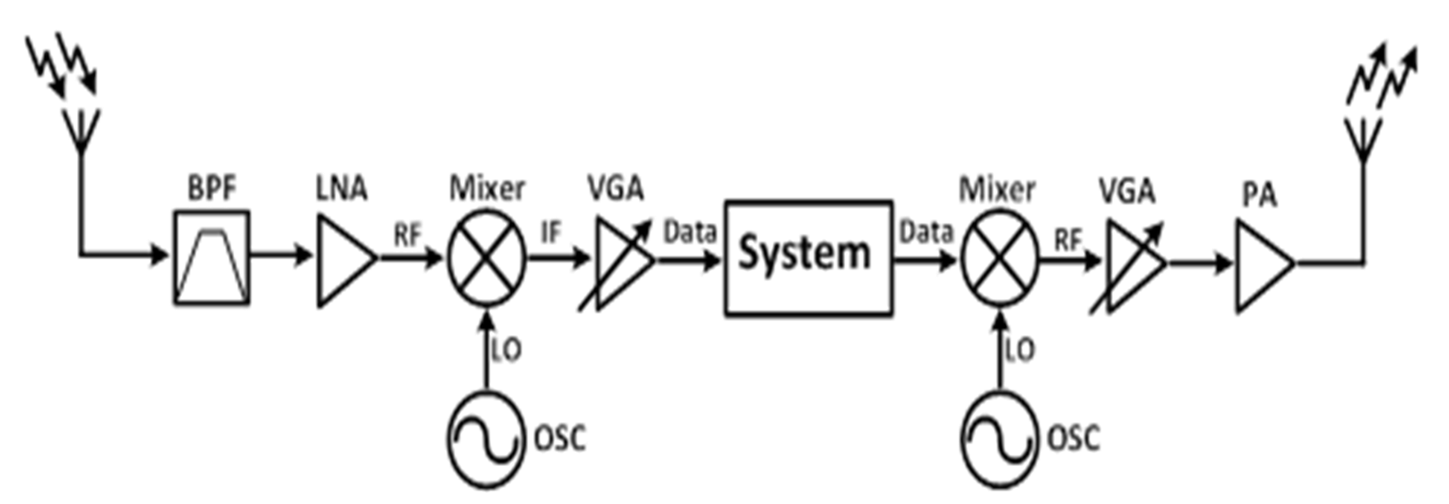
Transceiver architecture
A transceiver is a device comprising both a transmitter and a receiver that are combined and share common circuitry.

Slide 8
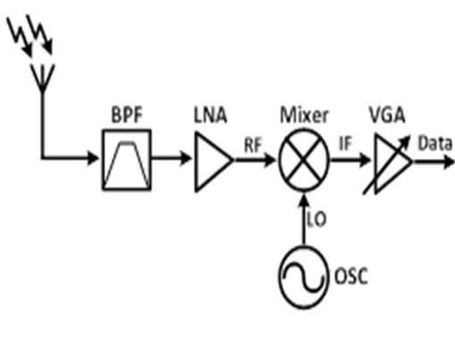
Receiver

Slide 9
Receiver
The main components of receiver are the Band Pass Filter, Low Noise Amplifier, Down Conversion Mixer, Oscillator and Variable Gain Amplifiers.
Band Pass Filter : A band-pass filter is a device that passes frequencies within a certain range and rejects frequencies outside that range.
Low Noise Amplifier : A low-noise amplifier is an active device that increases the amplitude of weak RF signals to allow processing by a receiver. In a receiver chain, the first amplifier after the antenna contributes the most to the system noise figure.
Down Conversion Mixer : A down-conversion mixer is a device that converts high frequency signals into low frequency signals.
Oscillator : An electronic oscillator is an electronic circuit that produces a periodic signal.
Variable Gain Amplifiers : A variable-gain amplifier is an active device that varies its gain depending on a control voltage.

Slide 10
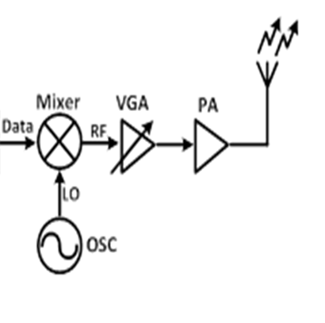
Transmitter

Slide 11
Transmitter
The main components of transmitter are the Power Amplifier, Up Conversion Mixer, Oscillator and Variable Gain Amplifiers.
Power Amplifier : A radio frequency power amplifier is a type of electronic amplifier that converts a low-power radio-frequency signal into a higher power signal.
Up Conversion Mixer : A up-conversion mixer is a device that converts low frequency signals into high frequency signals.
Oscillator : An electronic oscillator is an electronic circuit that produces a periodic signal.
Variable Gain Amplifiers : A variable-gain amplifier is an active device that varies its gain depending on a control voltage.

Slide 12
Two-Port Network
The two-port network circuit can be defined as a two-port network, whether it is a receiver circuit or a transmitter circuit.

Slide 13
The physical meaning of the S parameter
S parameter :
S11 is the reflection coefficient at port 1.
S22 is the reflection coefficient at port 2.
S21 is the forward gain or the transmission coefficient from port 1 to port 2.
S12 is the transmission coefficient from port 2 to port 1 or the backward gain.
For a RF circuit, S11 is the input impedance of the circuit, S22 is the output impedance of the circuit, S21 is the gain of the circuit and S12 is the isolation of the circuit.

Slide 14
Impedance Matching
In electronics, impedance matching is the practice of designing the input impedance of an electrical load or the output impedance of its corresponding signal source to maximize the power transfer or minimize signal reflection from the load.

Slide 15


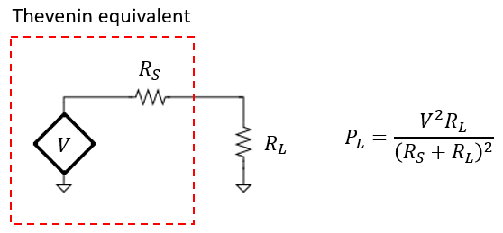
Maximum power transfer

Slide 16
Maximum power transfer

Slide 17
Practice Question 1
Try increasing the circuit to give it with good impedance matching performance at 2400MHz. (the source resistance and load resistance are both 50 ohms, and capacitor (0.1pF) in the figure may be a transistor gate capacitor.)

Slide 18
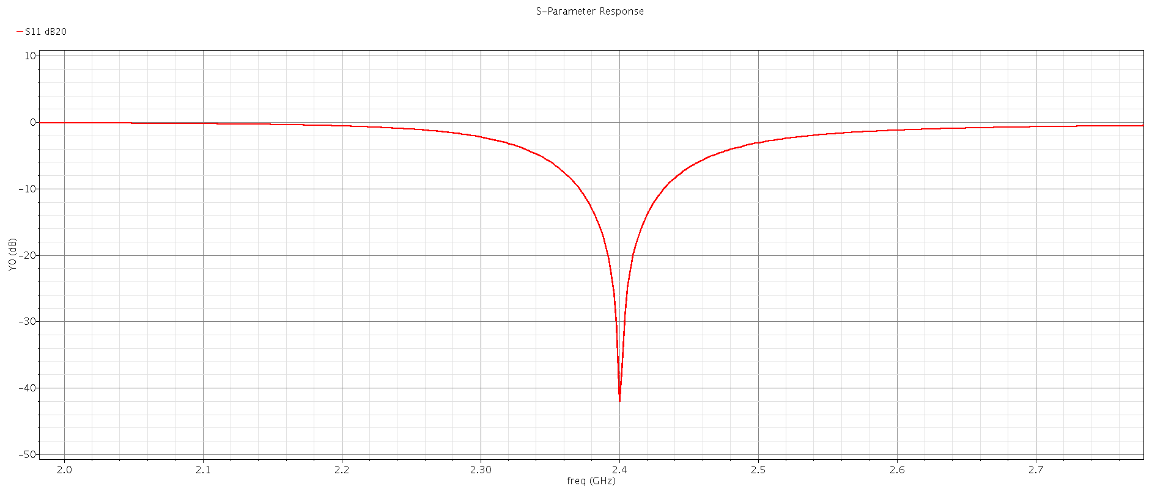
Practice Question
This is the result we want to get. Please use the virtuoso simulator to implement this circuit.

